Slide 1




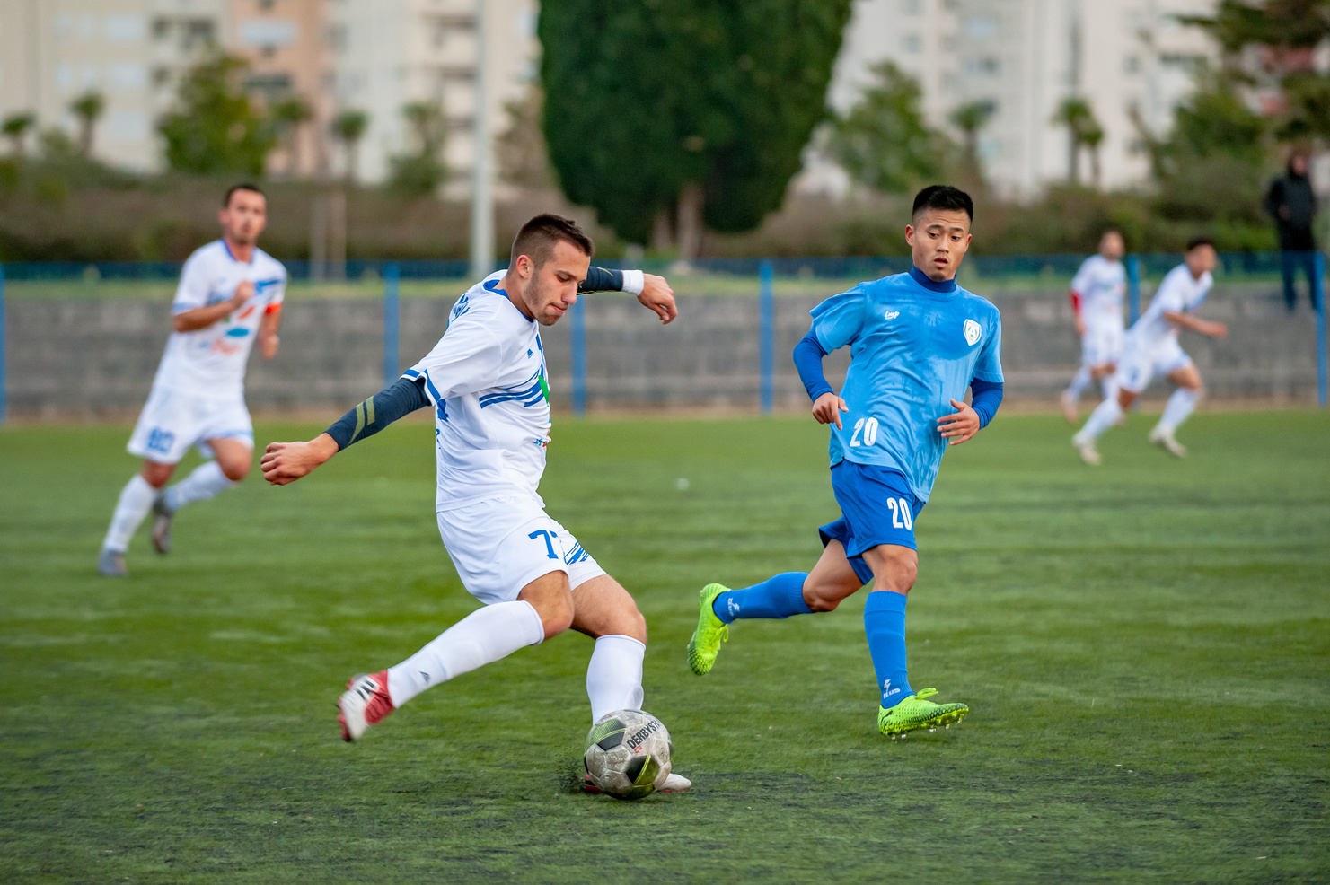
ICS 474 - Big Data Analysis
Insights and Predictions of Football Players
Team Excellegent
25 November 2024

Slide 2








Team Members
Ahmed Shewaikan
Turki Almutairi
Ali Alsaleh
Computer Scinece
Software Engineer
Industrial Engineer

Slide 3
DATA EXPLORATION

Slide 4



Dataset Overview
Origin
Kaggle’s European Soccer Database (2008-2016).
Problem Domain
Analysis of player performance metrics and predictive modeling for overall ratings.

Slide 5
Feature Description
Feature | Data Type | Description
id | Numerical | Unique identifier for each entry in the player attributes table.
overall_rating | Numerical | Overall performance rating of the player.
potential | Numerical | Player's potential rating.
Reactions | Numerical | Reflex speed and response to gameplay.
Ball Control | Numerical | Ability to maintain possession under pressure.
Short Passing | Numerical | Accuracy in close-range passing.
Standing Tackle | Numerical | Defensive ability to win the ball without fouling.

Slide 6
Structure & Missing Values
Dataset Structure
Missing Values
Rows: 18,207 records.
Potential, Reactions, and Ball Control are missing ~836 values.
Columns: 42 features
Linked to Player table
No missing values for Short Passing and Standing Tackle.
Duplicates: None found in the dataset.
Impact: Missing values could bias performance analysis; imputation strategies required.

Slide 7
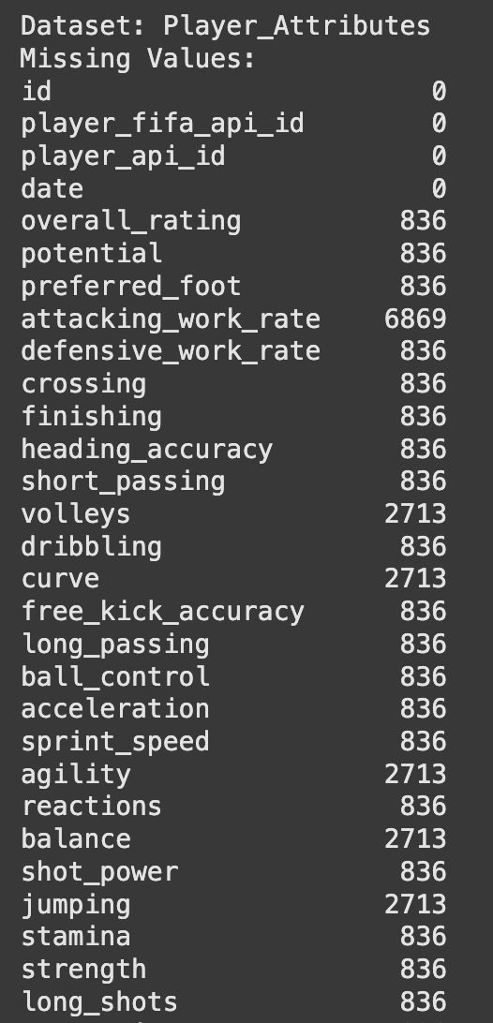
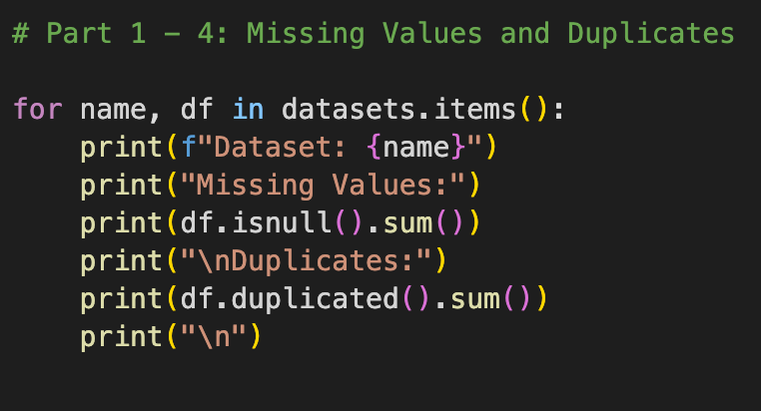

Slide 8
Statistical Summary
Feature | Mean | Median | Std. Dev
overall_rating | 68.6 | 67 | 7.04
potential | 71.5 | 72 | 9.4
Reactions | 59.8 | 61 | 10.1
Ball Control | 63.9 | 65 | 10.2
Short Passing | 63.5 | 64 | 10.4
Standing Tackle | 58.1 | 59 | 10.6

Slide 9
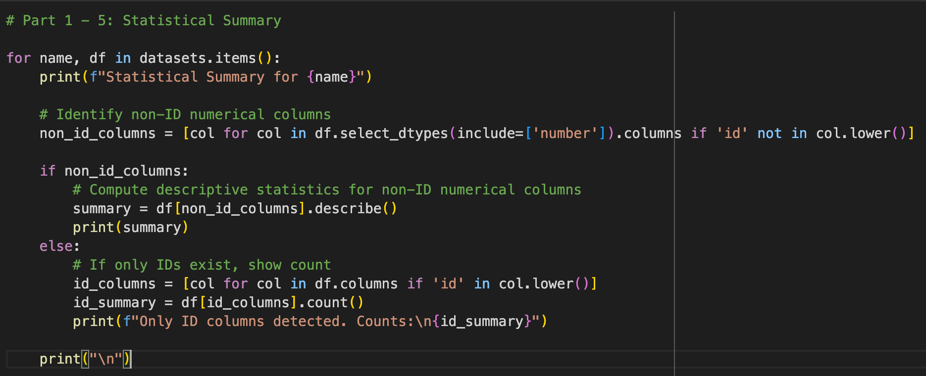
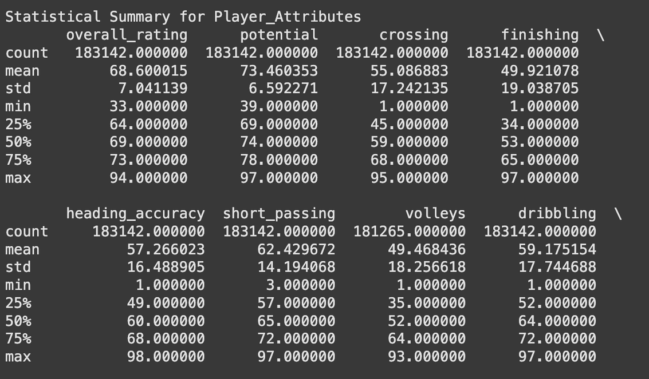

Slide 10
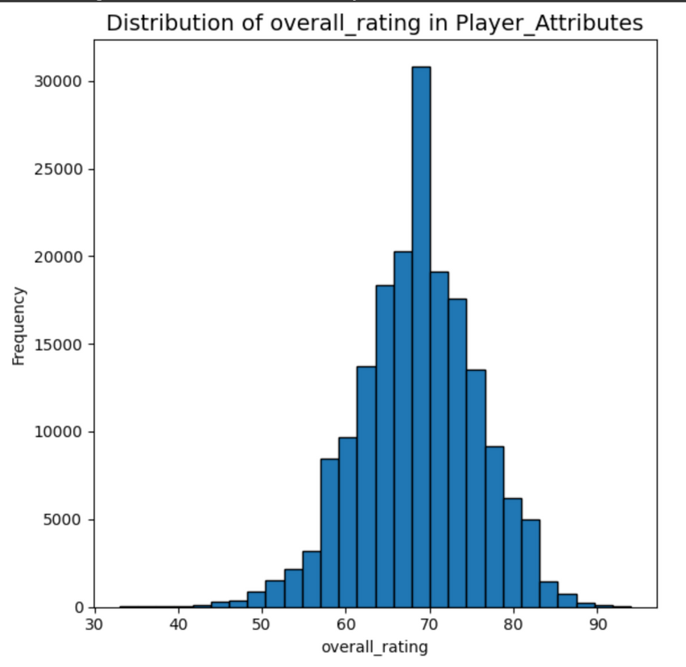
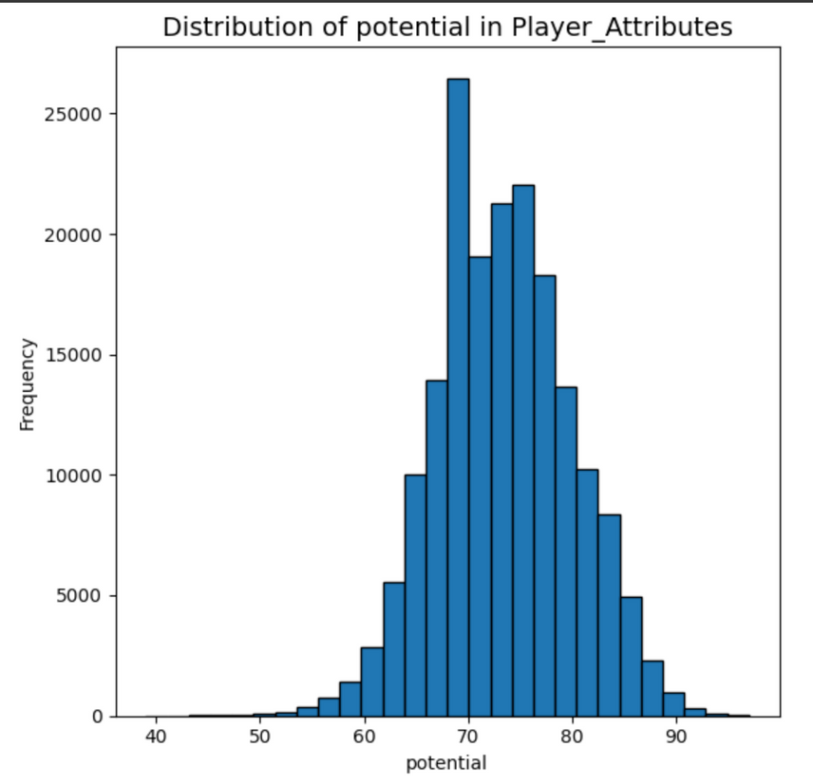
Data Distribution
overal_rating (bell-shaped) - Potential (normal distribution)

Slide 11
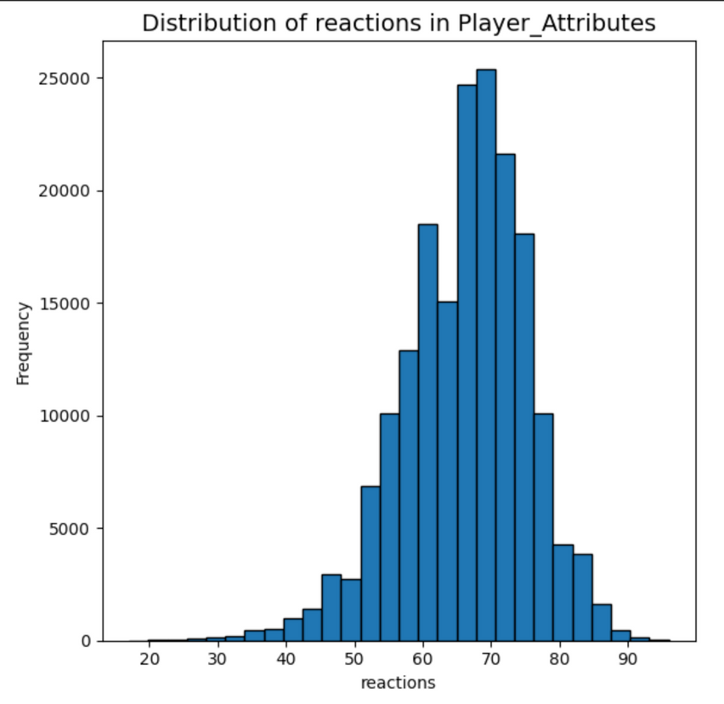
Data Distribution
reaction (normal distribution) - slightly skewed

Slide 12
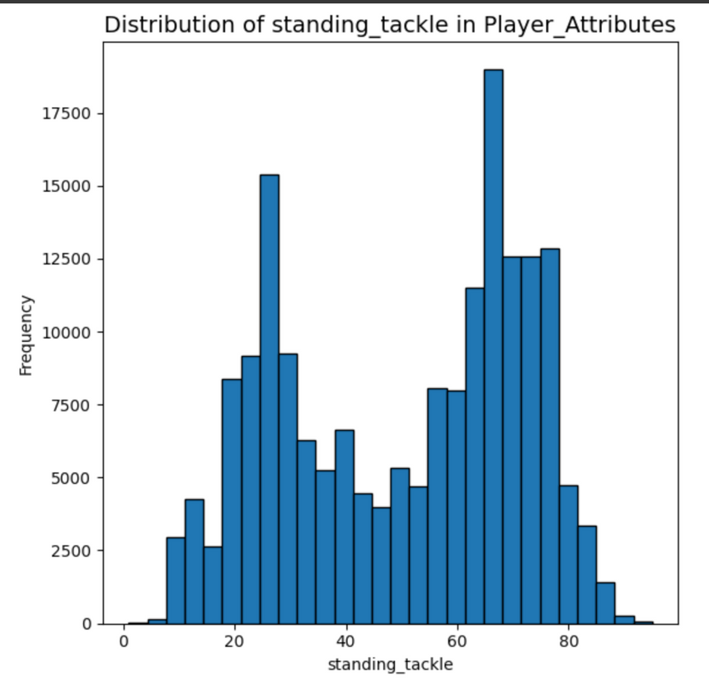
Data Distribution
sliding_tackle (bi-modal distribution)

Slide 13
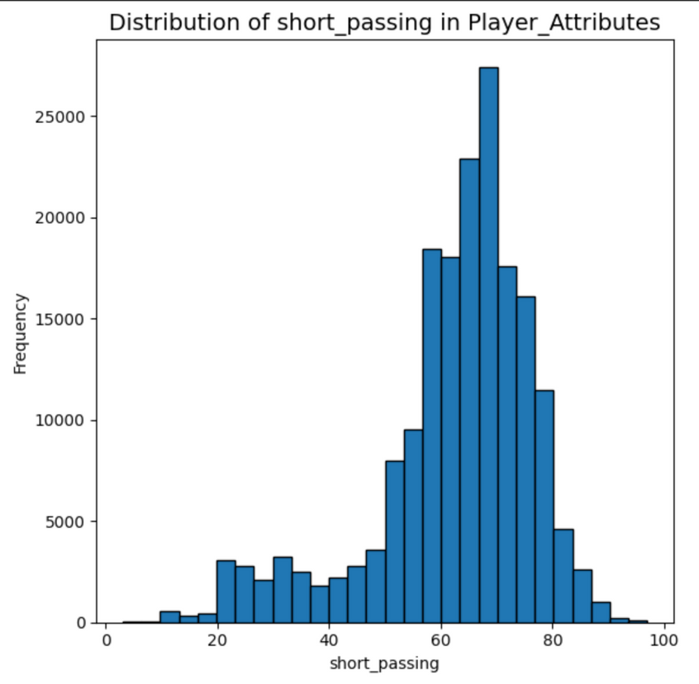
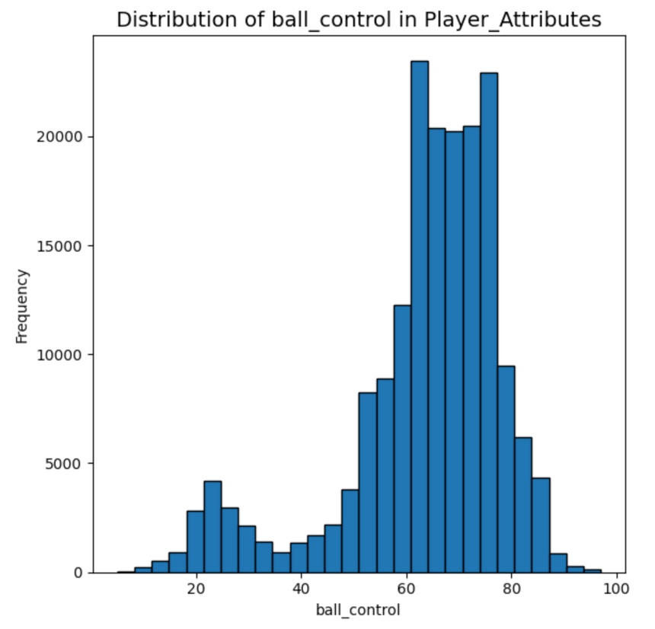
Data Distribution
Both have distribution that indicate higher clustering near the upper end

Slide 14
DATA PREPROCESSING

Slide 15

Data Preprocessing
Handling Missing Data
Used deletion to handle missing numeric and categorical values in the dataset.
Feature Scaling
Feature scaling was not applied as the Random Forest model is scale-invariant. All features already lie within a comparable range (0–100).
Feature Selection
These features (Potential, Reactions, Ball Control, Short Passing, Standing Tackle) exhibited strong correlations with the target variable (overall_rating).

Slide 16
DATA VISUALIZATION

Slide 17
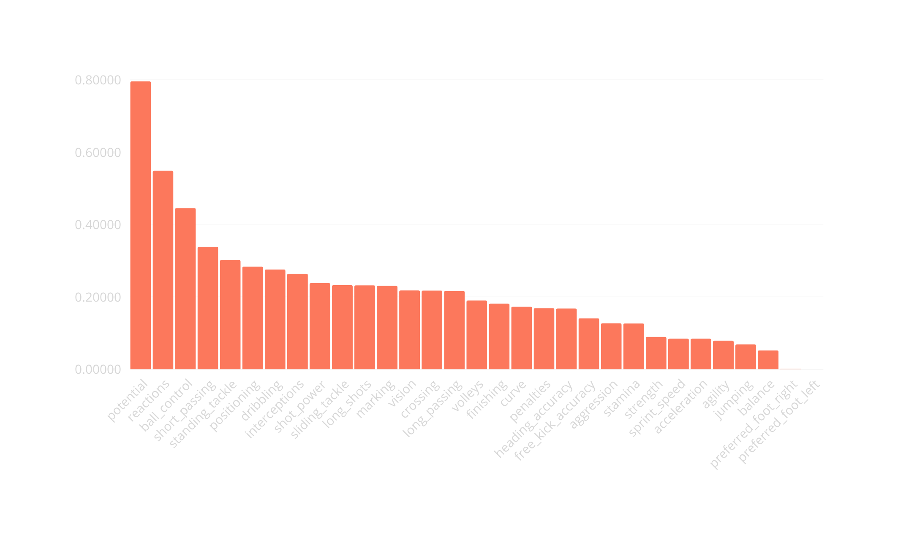

correlation

Slide 18


Correlation Analysis
31
0.79514
0
Features
potential
preferred_foot_left
18

Slide 19
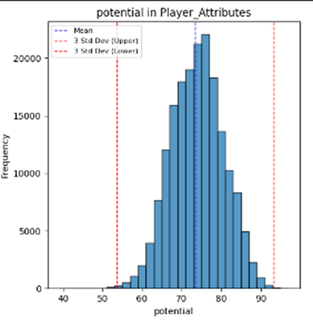
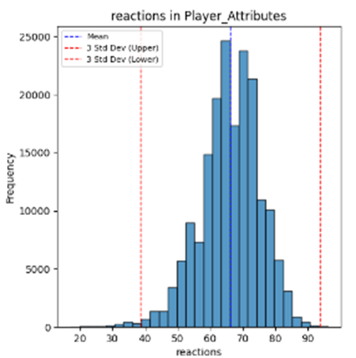
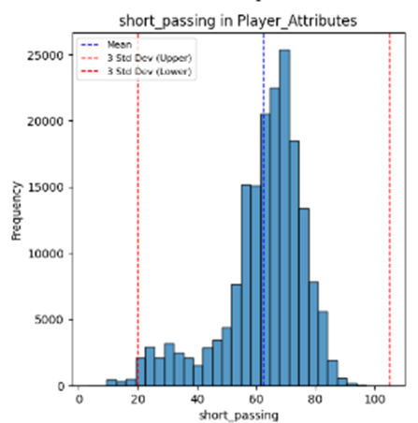
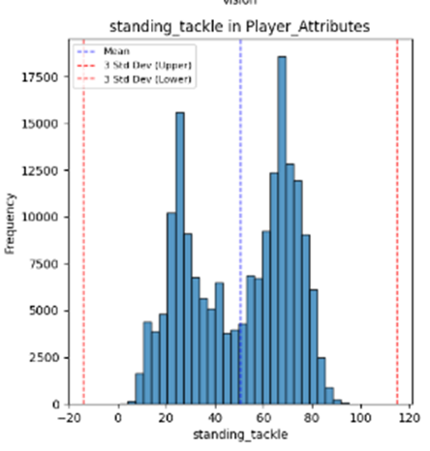
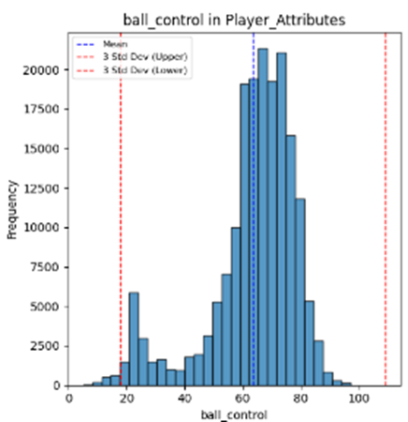
Outliers in Numerical Attributes
Checking for Outliers in the Features

Slide 20
MODELING

Slide 21

Chosen Model
Justification and Metrics
We chose Random Forest, A meta estimator used to fit multiple decision trees.
Why Random Forest?
Metrics
Good for overfitting control
MSE: Explains the value of error in the model
Simplicity
R Squared: how much of the model is justified from the selected feature
Flexible
indifferent to Fine Tuning

Slide 22
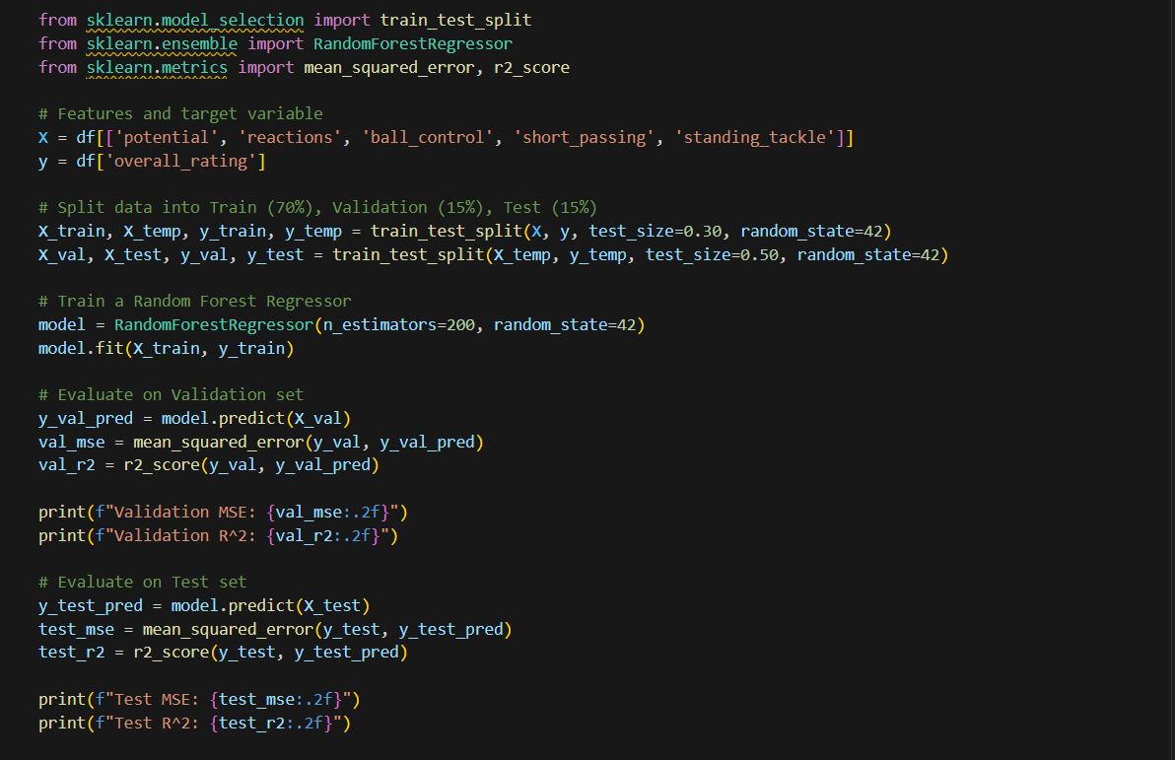
Modeling - Building the model
Snippet of the model code

Slide 23
RESULTS
MSE
R Squared
2.67 on validation set
0.95 on validation set
2.63 on Test set
0.95 on Test set*

Slide 24
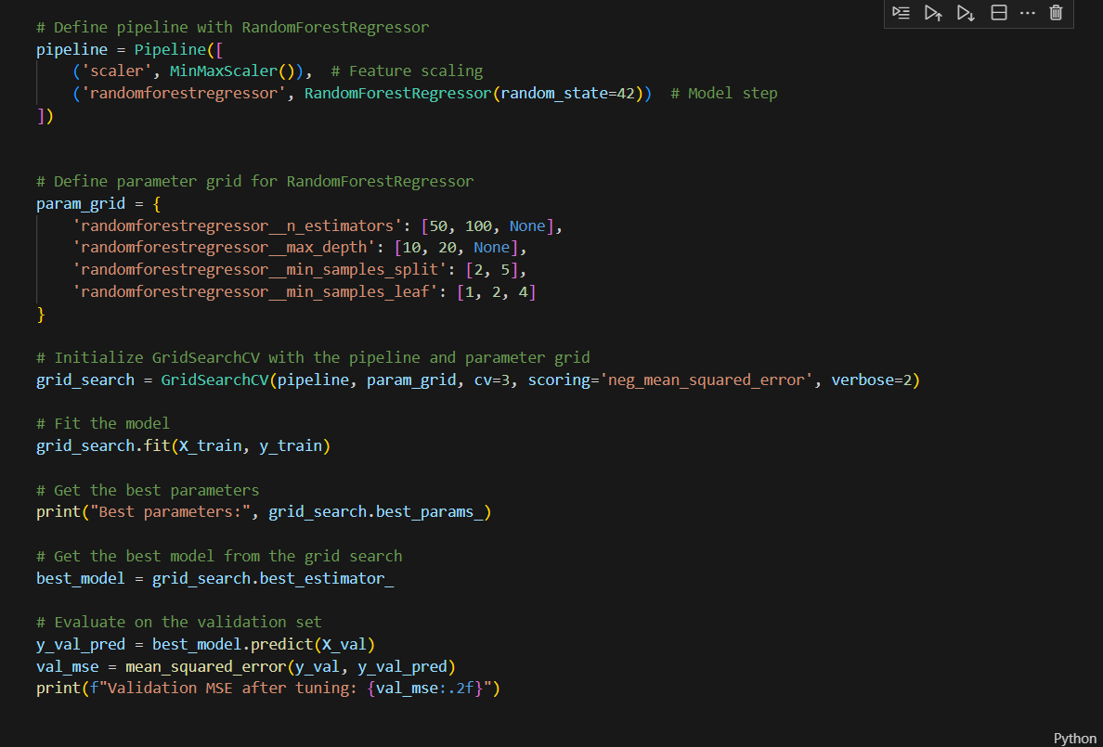
Improving - Tuning The Model
Snippet of the Grid search code

Slide 25
BEST PARAMETERS
Max Depth = None
n_estimators = 200
min_samples_leaf = 1
min_samples_split = 2

Slide 26


Fine Tuning
BEFORE FINE TUNING
MSE = 2.67
A Comparison of Mean Square Error and R Squared before and after Fine Tuning.
FINE TUNING
GRID SEARCH
Method Used
We used Grid Search for hyper parameters fine tuning
AFTER FINE TUNING
MSE = 2.63

Slide 27
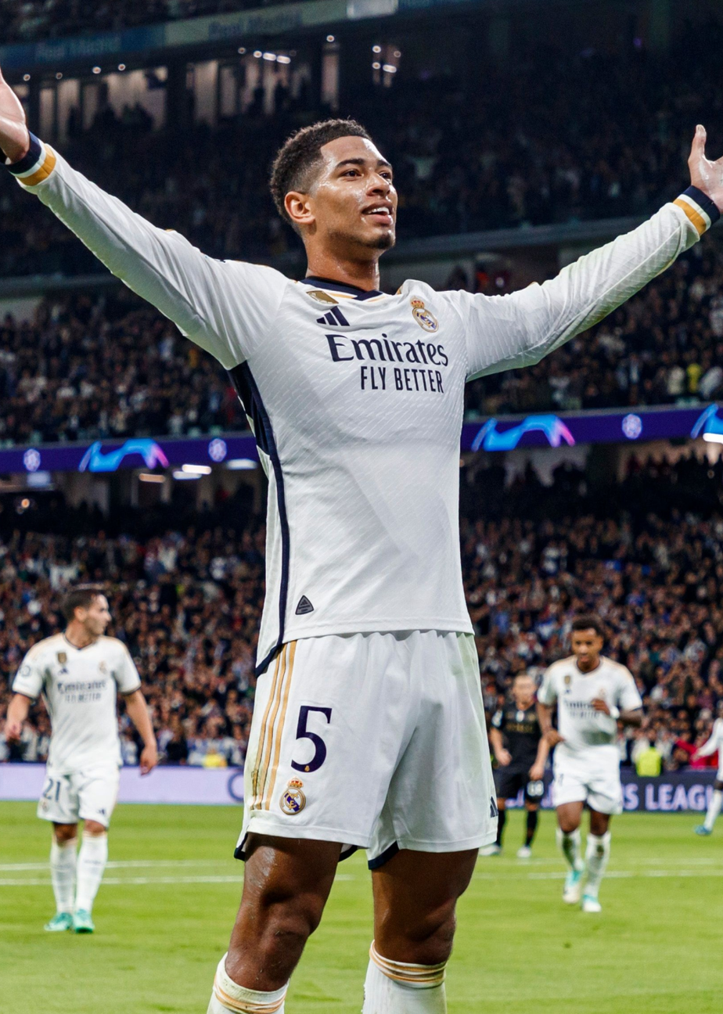
Conclusion
Best Model
Random Forest emerged as the most effective model for predicting player performance.
Top Predictive Features
The features with the highest impact on overall rating were Potential, Reactions, Ball Control, Short Passing, and Standing Tackle.
Project Impact
Revised Python programming skills and reinforced AI fundamentals through data preprocessing, feature selection, model evaluation, and visualization techniques.
27

Slide 28


Thank You

